Slide 1





OPIM 5671
Data Mining and Business Intelligence
GROUP 3
Meet our Team
Sparsha Akula
Juhi Gupta
Vasudha Mishra
Kanika Gaikwad
Shubham Deshmukh
Climate Change Data from 1750-2015

Slide 2
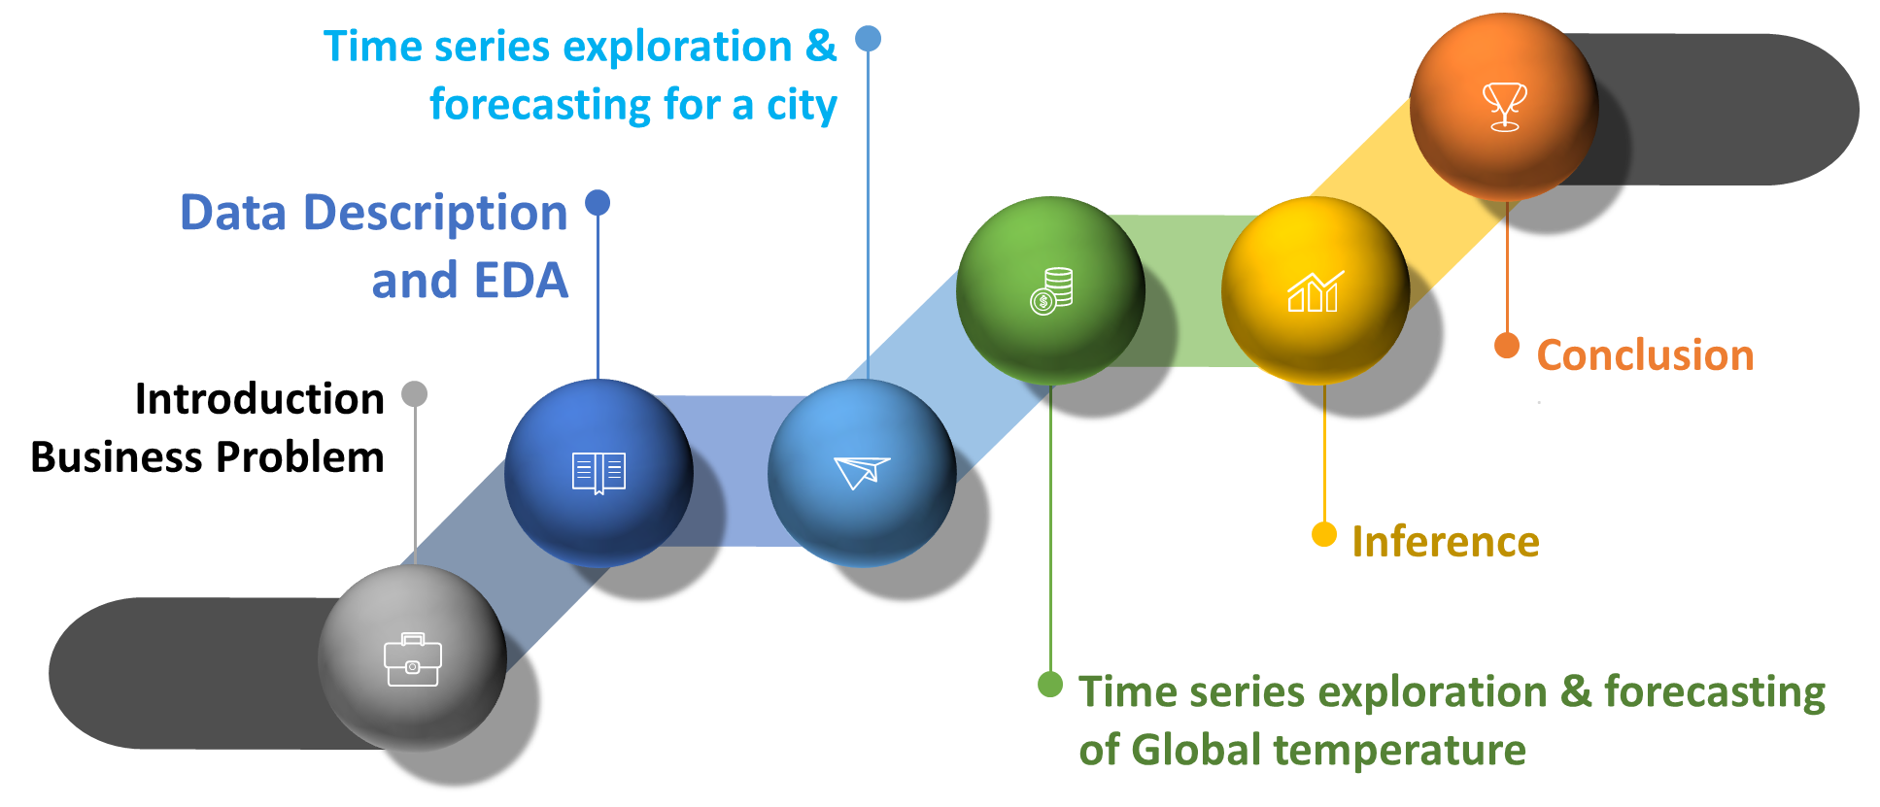
Agenda

Slide 3
01
Introduction
Business Problem

Slide 4
Introduction
1940
Removed weather station for airport construction
1980
move to electronic thermometers that are said to have a cooling bias
2010
4.8 degree celsius in 50 years

Slide 5
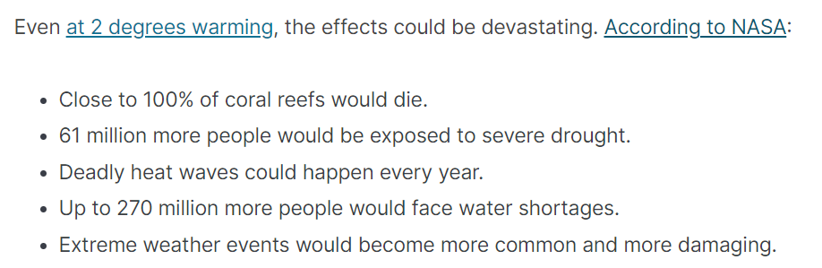
Business Problem
Problem Statement :
This research analyzes present and predicted land and ocean MAXIMUM, MINIMUM and AVERAGE temperatures on earth to understand the impact of global warming on the ecosystem and human societies.
It aims to inform government agencies, policymakers, and the public about the severity of the situation and develop effective strategies to reduce greenhouse gas emissions.
https://www.kaggle.com/datasets/berkeleyearth/climate-change-earth-surface-temperature-data?datasetId=29&sortBy=voteCount

Slide 6
02
Data Description
EDA

Slide 7
Dataset Description and EDA
https://www.kaggle.com/datasets/berkeleyearth/climate-change-earth-surface-temperature-data?datasetId=29&sortBy=voteCount
Column | Data type | Description
Date | Datetime | Date of the temperature reading
LandAverageTemperature | Float | Average temperature of land (in Celcius)
LandAverageTemperatureUncertainity | Float | Uncertainty of the average land temperature (95% Confidence interval around the avg)
LandMaxTemperature | Float | Maximum temperature of land (in Celcius)
LndMaxTemperatureUncertainity | Float | Uncertainty of the maximum land temperature (95% Confidence interval around the maximum)
LandMinTemperature | Float | Minimum temperature of land(in Celcius)
LandMinTemperatureUncertainity | Float | Uncertainty of the minimum land temperature (95% Confidence interval around the minimum)
LandAndOceanAverageTemperature | Float | Average temperature of land and ocean(in Celcius)
LandAndOceanAverageTemperatureUncertainity | Float | Uncertainty of the average land and ocean temperature (95% Confidence interval around the avg land and ocean temperature)

Slide 8
03
City
Time Series Exploration and Forecasting

Slide 9
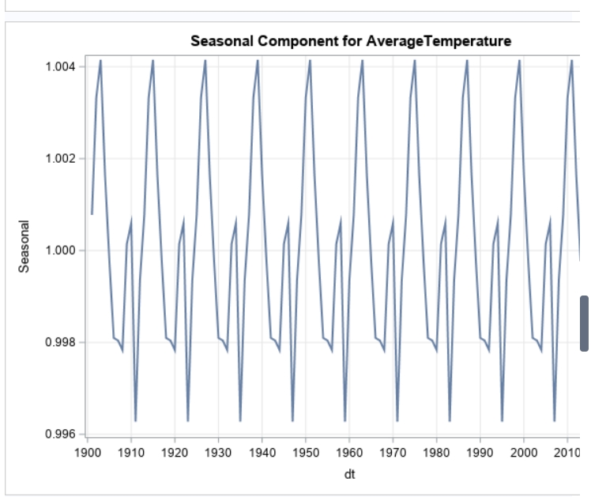
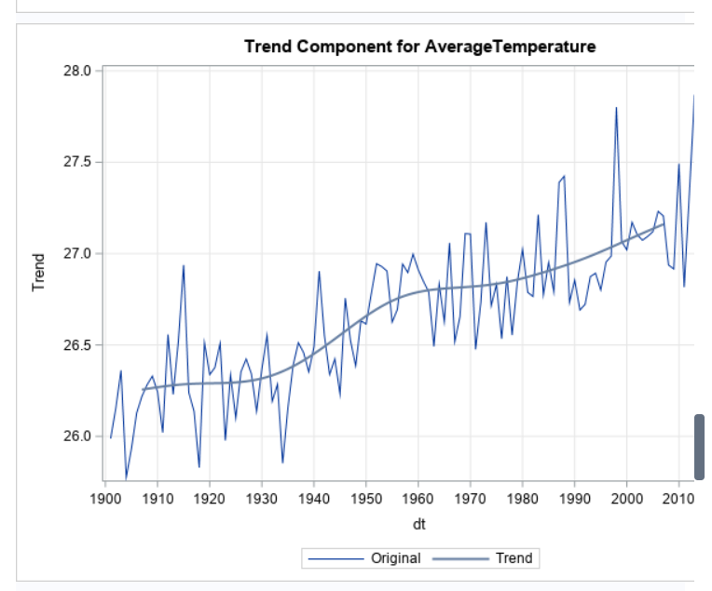
City Temperature
Seasonality
Trend

Slide 10
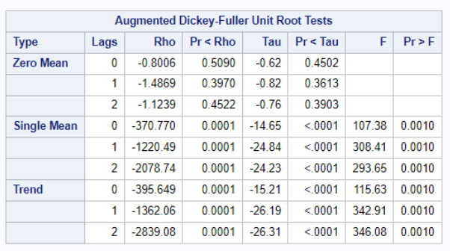
ADF Test
Check for stationarity

Slide 11
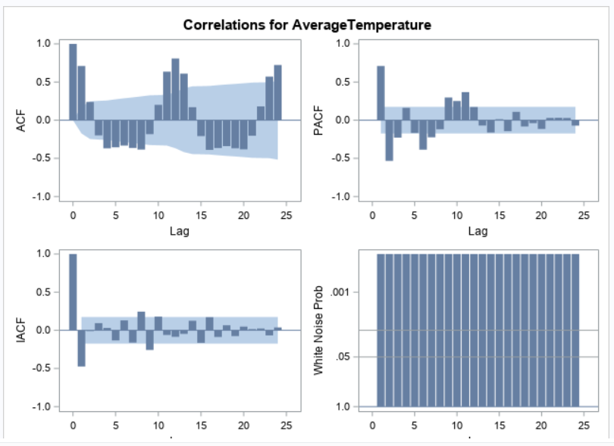
Time Series Exploration

Slide 12
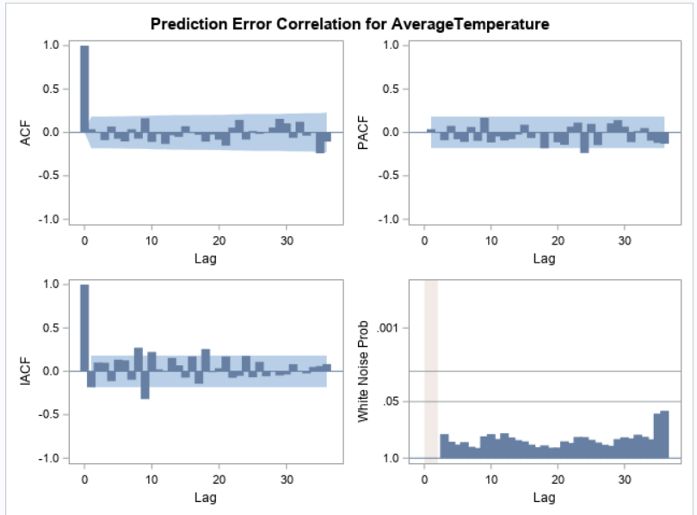
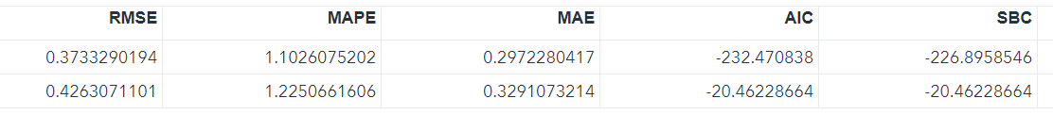
Exponential Smoothing
Winter’s Additive Method

Slide 13
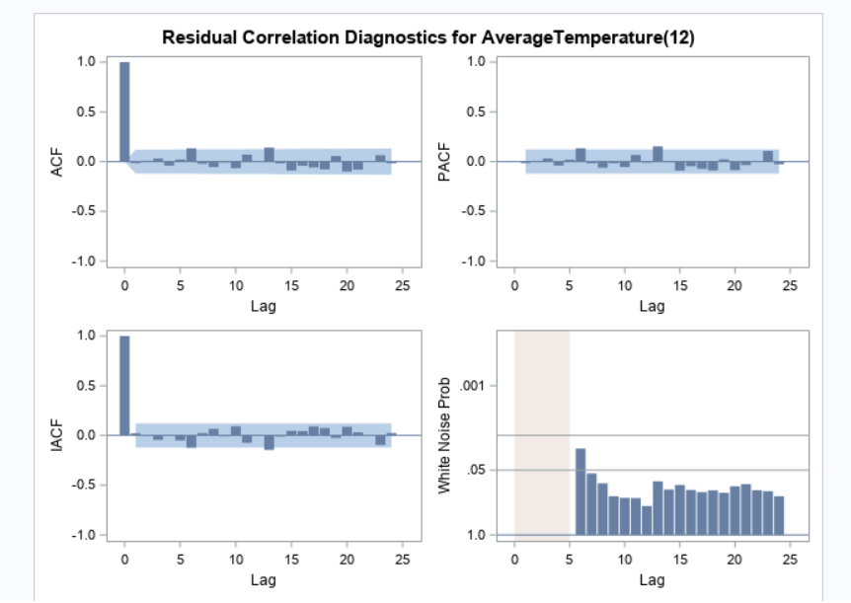
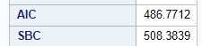
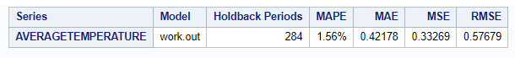
ARIMA
(p,d,q → 3,0,1,2,1,1)

Slide 14
04
Global Temperature
Land and Ocean
Temperature

Slide 15
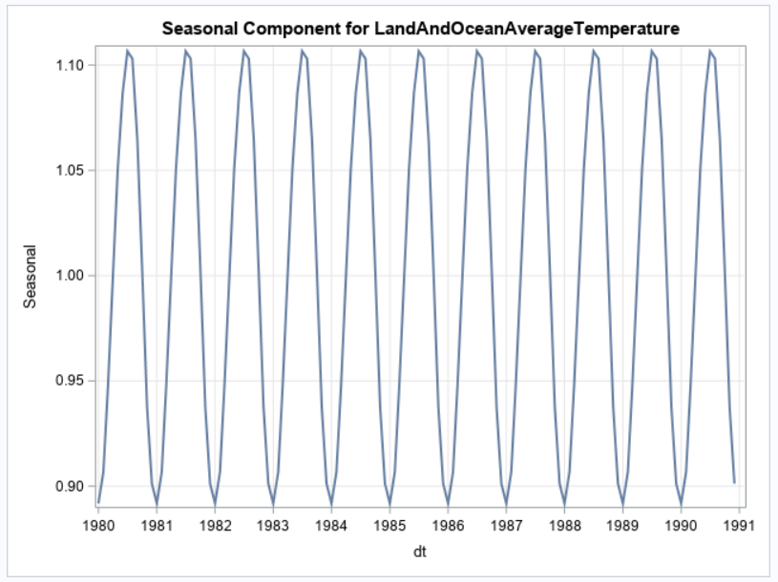
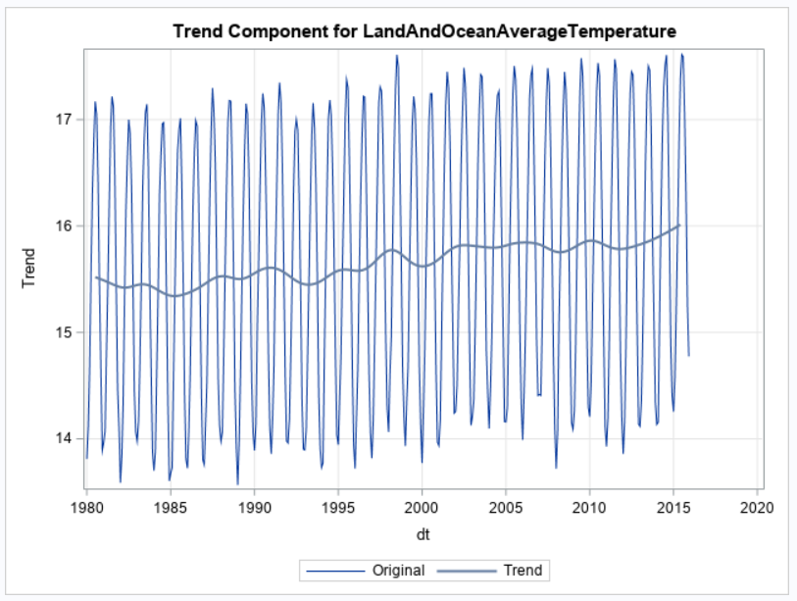
Land and Ocean
Temperature
Seasonality
Trend

Slide 16
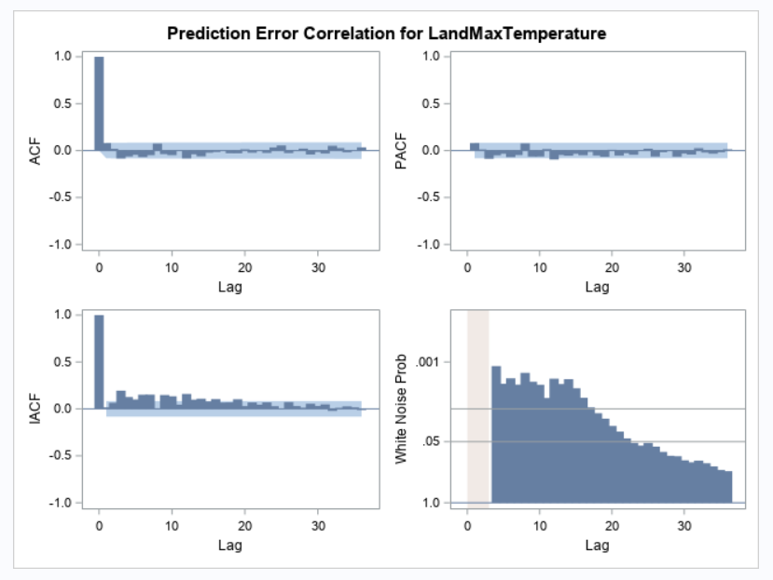
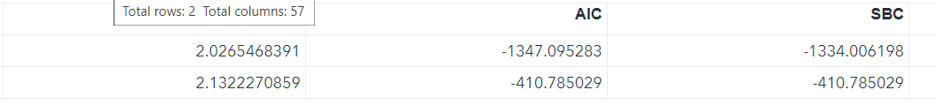
Exponential Smoothing

Slide 17
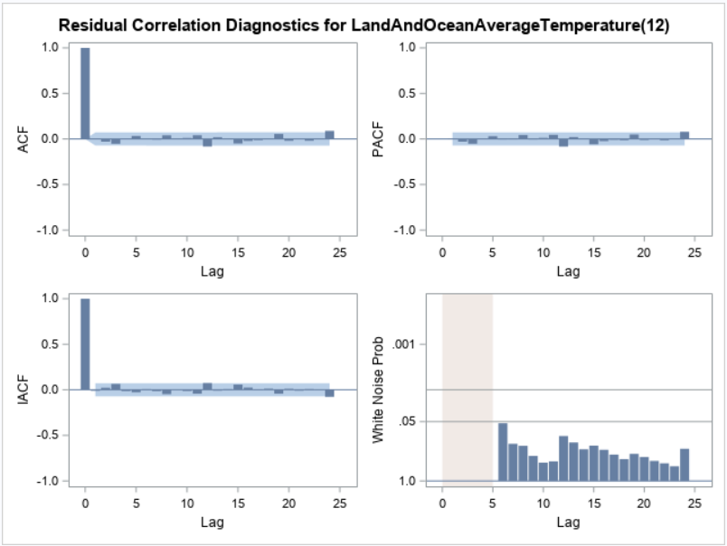
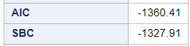
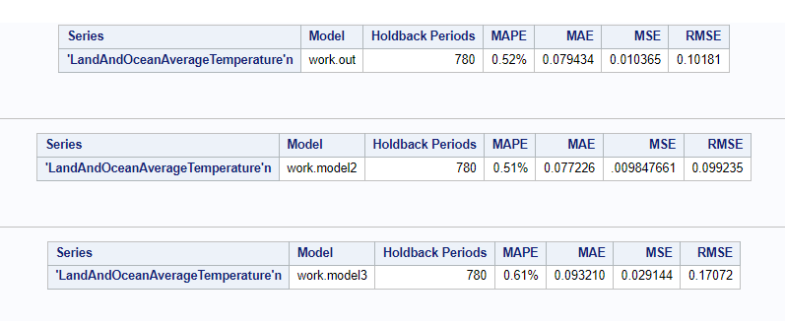
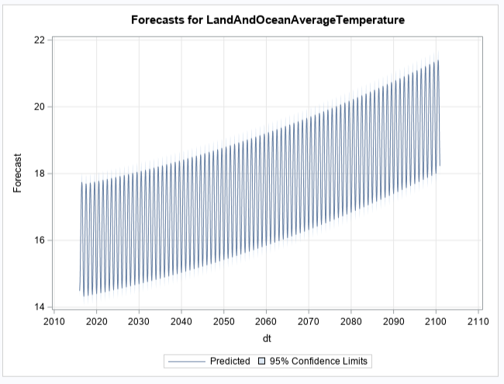
ARIMA
(ARIMA(2,0,2)(0,1,1))s

Slide 18
05
Insight
And
Conclusion

Slide 19

Insight
Analyzing the previous dataset, our model forecast gradual increase of 6.5 degrees globally by year 2100.

Slide 20
Conclusion
Parameters
MAPE, AIC, SBC
Atlanta City Temperature Analysis:
Exponential Smoothing has lower values than ARIMA
Global Temperature Analysis:
ARIMA has lower values than Exponential Smoothing Model

Slide 21
THANKS!

